Slide 1
An FPGA-Based Instrument for RRAM Characterization
Debasish Panda [21d070021]
Deshpande Varad Shailesh [21d070024]
Grampurohit Shreyas Jayant [21d070029]
Harshit Raj [20d070033]

Slide 2
What is the problem that we are trying to solve?
RRAM, or Resistive Random Access Memory, is a promising technology for the future of computing because it offers several advantages over conventional memory storage elements, such as compactness, faster speed, lower power consumption, and durability. We wish to implement an FPGA-based mechanism to characterize RRAM crossbar arrays for better understanding to enable performance optimization.

Slide 3
Ideal specifications as implemented in paper
The paper we have been provided with has designed an FPGA-based instrument with capabilities of on-board oscilloscope and nanoscale pulsing (70 ns @ ± 10V), thus allowing exploration of the nano-scale switching capabilities of RRAM devices. The system should ideally possess less than 1% read-out error for resistance range between 1 kΩ to 1 MΩ.
However, due to several practical considerations and the budget involved, we had to downscale the specifications appropriately. Detailed reasons have been provided in the subsequent slides.

Slide 4
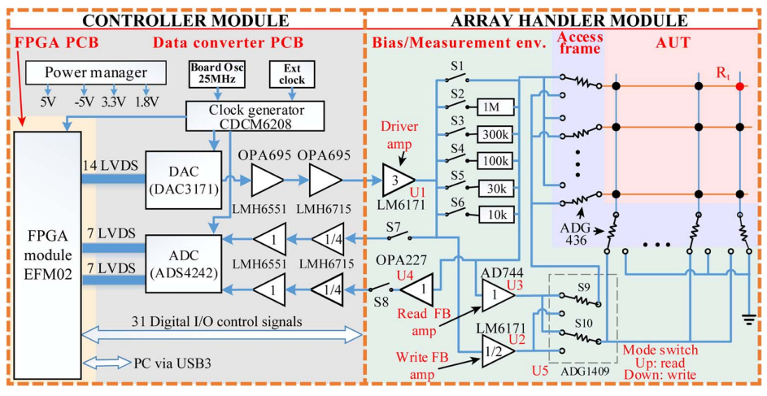
Design as implemented in paper^{[1]}
Nanoscale pulsing ability (70 ns)
Less than 1% read-out error for resistance range between 1 kΩ to 1 MΩ
± 10 V voltage range
14-bit DAC and ADC pathways
32 ⤫ 32 resistive crossbar array
Simplified array control instrument diagram. The system is partitioned into a controller and an array handler module^{[1]}.
[1] Jinling Xing, Alexander Serb, Ali Khiat, Radu Berdan, Hui Xu, and Themistoklis Prodromakis, “An FPGA-Based Instrument for En-Masse RRAM Characterization With ns Pulsing Resolution”, IEEE Trans. Circuits and Systems, vol. 63, no.6, 2016

Slide 5
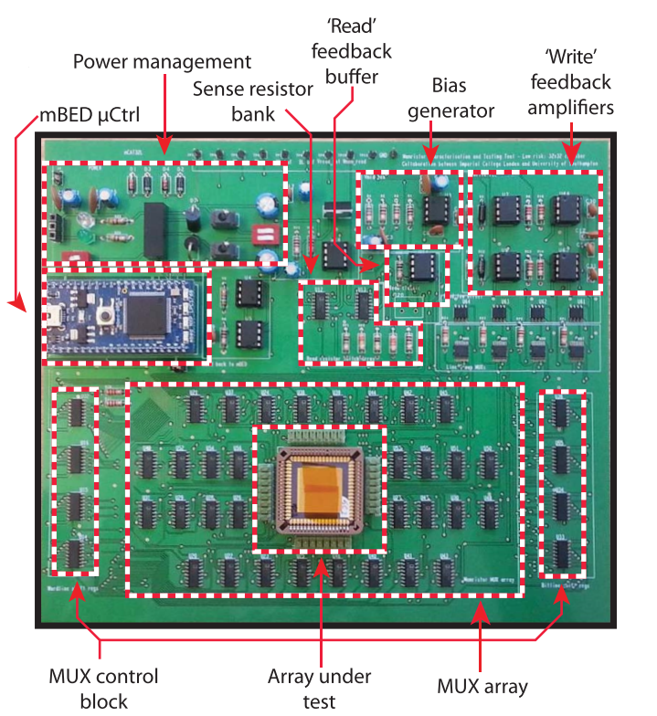
Design as implemented in paper^{[2]}
PCB implementation of a 𝜇-controller-based system (mCAT) for RRAM characterization as presented in the research paper^{[2]}. Note that we shall be using an FPGA module for characterization and interfacing instead of a 𝜇-controller.
[2] Radu Berdan, Alexander Serb, Ali Khiat, Anna Regoutz, Christos Papavassiliou and Themis Prodromakis, “A 𝜇-Controller-Based System for Interfacing Selectorless RRAM Crossbar Arrays”, IEEE Trans. Electron Devices, vol.62, no.7, 2015

Slide 6
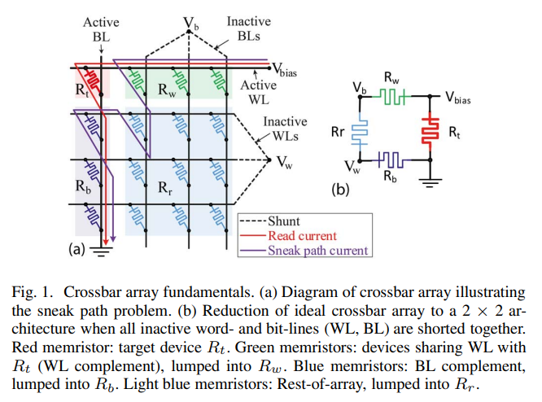
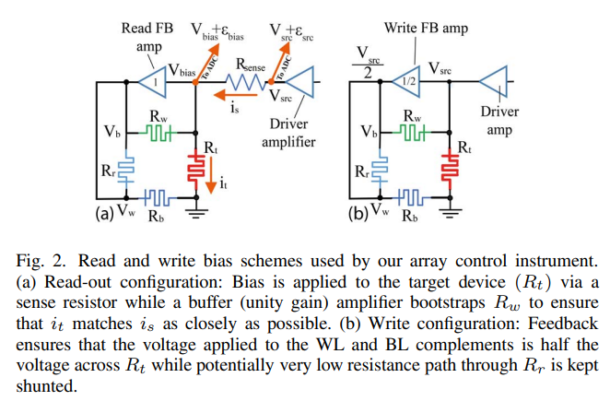
Principle of operation^{[1]}
[1] Jinling Xing, Alexander Serb, Ali Khiat, Radu Berdan, Hui Xu, and Themistoklis Prodromakis, “An FPGA-Based Instrument for En-Masse RRAM Characterization With ns Pulsing Resolution”, IEEE Trans. Circuits and Systems, vol. 63, no.6, 2016

Slide 7
Practical target specifications
10 𝜇s to 100 𝜇s pulsing capability
In order to achieve nanoscale pulsing, we would require ADC and DAC having very high sampling rate (around 50 MSPS). However, they are extremely expensive and well over the allotted budget. Further, using nanoscale pulses would cause propagation delays in the PCB. Hence, we settle with 𝜇s pulsing capability.
± 5 V voltage range
We reduce this range in order to be able to attain decent range of resistance values of memristors and yet not make the ADC and other components expensive.

Slide 8
Practical target specifications (contd.)
8 ⤫ 8 resistive crossbar array
Implementation of a 32 x 32 array would require too many switches and would be difficult to implement in a 2 layer PCB.
Resistance range between 10 kΩ and 100 kΩ
This is based on the voltage range and the pulse duration that we have decided.
12-bit DAC and 16-bit ADC pathways
This is to ensure a good resolution of measurement. To make measurements, we will give out a pulse of ~10 mV and 5V/0.5 mV needs ~ 12 bits.

Slide 9
Value proposition
RRAM is a highly developing field with the following advantages:
Potential to revolutionize storage: Could replace flash storage in devices like smartphones and laptops due to its speed, size, and energy efficiency.
Emerging applications: Being explored for use in artificial intelligence (AI) and neuromorphic computing due to its ability to mimic brain functions.
Research focus: Many companies and research institutions are actively developing RRAM technology, with significant advancements happening.
If we successfully develop a cheap implementation of RRAM characterisation it will be very helpful in multiple domains, including the ongoing research in the institute.

Slide 10
Methodology
We will first go through the design implemented in the paper and make the necessary changes in it based on the components we have selected and the specifications we need to achieve.
Next, we shall start working in parallel on the VHDL implementation and the PCB design.
After a rigorous verification of the schematic, PCB design and the VHDL code, we will assemble the circuit and test it. We will first test on an 8 ⤫ 8 resistive crossbar array instead of using an RRAM directly.
Finally, after testing on the actual RRAM device, we will make an interface to display the characterisation output on to a laptop display, with the help of PicoIRIS platform if needed.

Slide 11
Choice of components
Amplifiers: The current we need to measure is of the order of nA, and thus even a small noise in any signal would disrupt the readings. Further, the pulses have a duration of the order of 𝜇s, hence we need low noise, high-speed amplifiers, although they are pretty expensive
ADC & DAC: We need a differential input, dual channel 16 bit ADC with at least 1Msps ADC. For the 12 bit DAC, we need a current-output, rise/fall times ~ ns to get a sharp pulse output for programming the RRAM.
FPGA module: The Xen-10 board available in the WEL lab operated at 50MHz seems sufficient for our task.
Switches: MAX4737 which has off current is ~nA, fast switching ~ns, can sustain ~10V across it in open configuration - matching the specifications for our design. This is available in WEL Lab.

Slide 12
Power considerations
Aim: To power a) Xen 10 board b) our PCB with 5V
Usage: Li-ion battery from WEL. We will use a battery protection charger module(TP5100) to safeguard our circuit. A dc barrel jack will be used to plug into the PCB.
We will use Voltage regulator ICs(5V: LM7805, 3.3V:LM1117, 1.8V: LM1117)

Slide 13
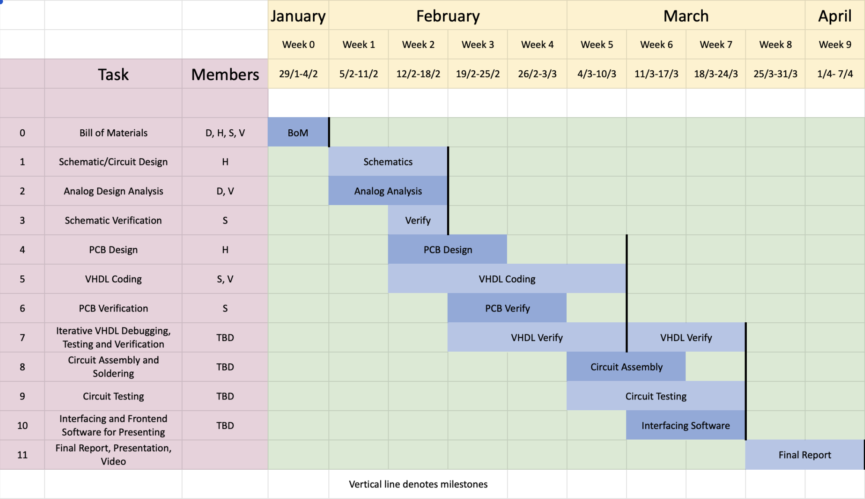
Gantt chart for project planning
D-Debasish, H-Harshit, S-Shreyas, V- Varad

Slide 14
Work distribution across team members
VHDL coding - Shreyas & Varad
PCB design - Harshit & Shreyas
Analog design - Debasish & Varad
Heat management in PCB - Debasish
Resistive crossbar prototype for RRAM - Harshit
Interfacing and frontend software - optional; whomever among Shreyas, Varad & Harshit finishes first will take up this task
VHDL debugging - Any two members
Circuit assembly & soldering - Same two members as involved in VHDL debugging
Week-wise goals
Week 0 - Bill of Materials
Week 1 - Schematic design + Analog design
Week 2 - Schematic design + Circuit design + Schematic verification + PCB design + VHDL coding
Week 3 - PCB design + VHDL coding + PCB verification + VHDL debug
Week 4 - VHDL coding + PCB verification + VHDL debug
Week 5 - VHDL coding + VHDL debug + Circuit assembly + Circuit testing
Week 6 - VHDL debug + Circuit assembly + Circuit testing + GUI
Week 7 - VHDL debug + Circuit testing + GUI
Week 8 - Final report
Week 9 - Final report

Slide 15
Key risks and mitigation strategies
Cost & Analog design: The design presented in the paper is an expensive high-speed, precision design. Due to cost (primarily of DAC and ADC) we cannot replicate it directly, and the challenge lies in a) identifying usage of every component b) finding a suitable alternative that matches specifications. Solution: Cumulative cost of op-amps used in the paper are not as costly as the ADC (~30k) and we can directly use them to preserve the design ideals and find ADC & DAC with a lesser sampling rate.
PCB Design: To support 𝜇s pulsing and have small track lengths to avoid delays.
Heat management: Given that the PCB has multiple components, heat management is a major cause of concern. Solution: Appropriate analysis will be done after PCB design to improve heat dissipation in the PCB.
Soldering SMD: None of the team members have any decent experience with soldering and it will take some guidance from faculty and staff to teach us the same.

Slide 16
Deliverables (expected outcomes of the project)
Functional board that is an economical replication of the prototype presented in the paper.
To develop a user-friendly frontend application for the board, with the picoIRIS platform as a reference.

